Slide 1



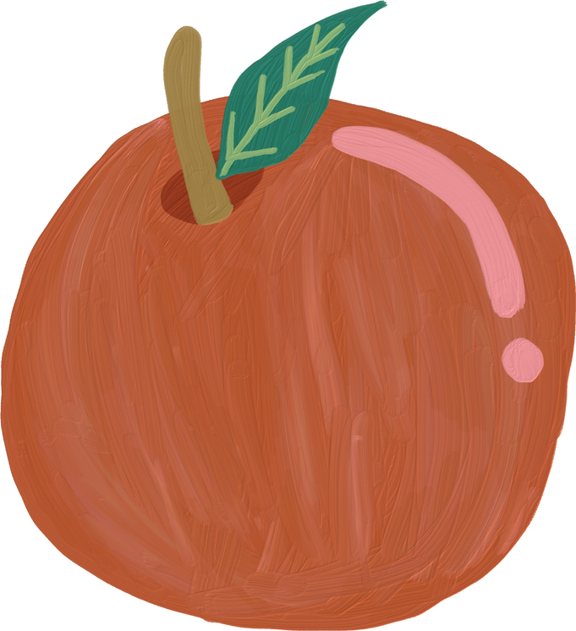
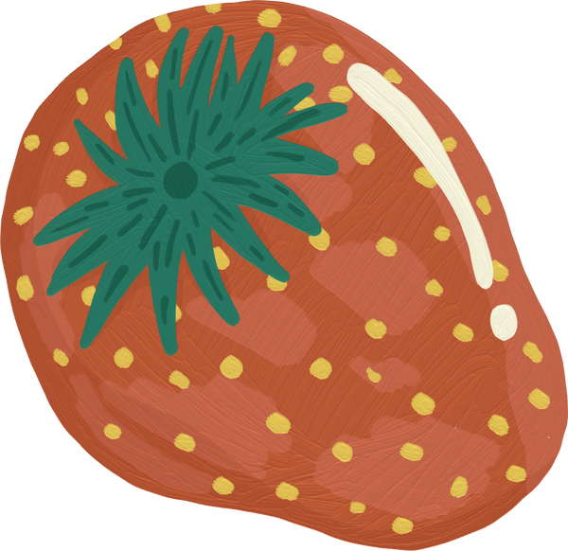
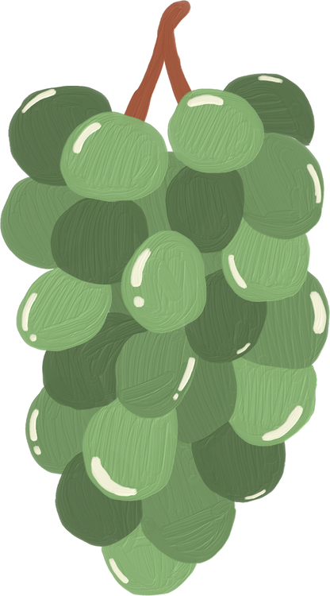

FRUITS & VEGETABLES RECOGNITION SYSTEM

Slide 2


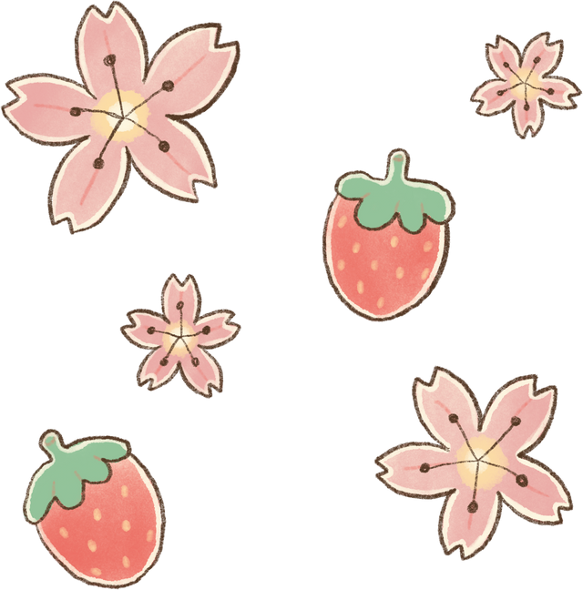
Our Team
Dina Mohamed
Eman Ramzy
Shorouq Hossam
Amina Mohamed

Slide 3


AGENA
Problem
Key Findings
Approach
Results

Slide 4

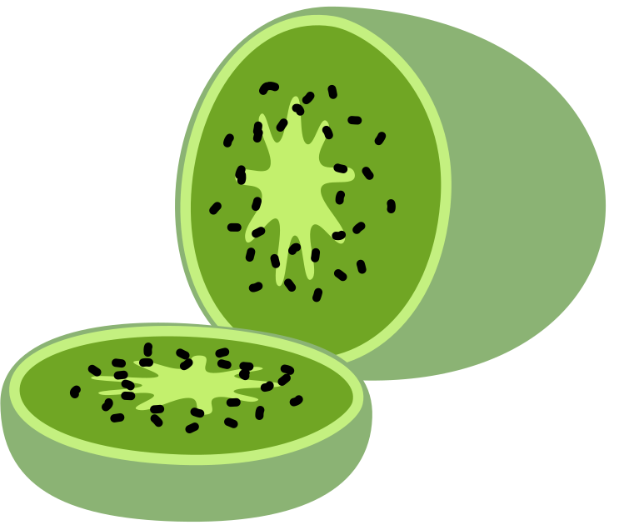

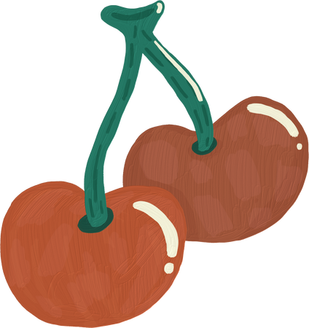
INTRODUCTION
Dataset: Fruits-360
Images: 90,483
Categories: 131 (fruits and vegetables)
Training set: 67,692 images
Test set: 22,688 images
Image size: 100x100 pixels
Filming: Logitech C920 camera
Background removal: Specialized algorithm

Slide 5


PROBLEM
Our primary objective is to create a robust classification system that leverages Deep Learning techniques to accurately identify and categorize 131 species of fruits and vegetables. By harnessing the power of artificial intelligence, we aim to enhance inventory management, supply chain optimization, and nutritional analysis.

Slide 6
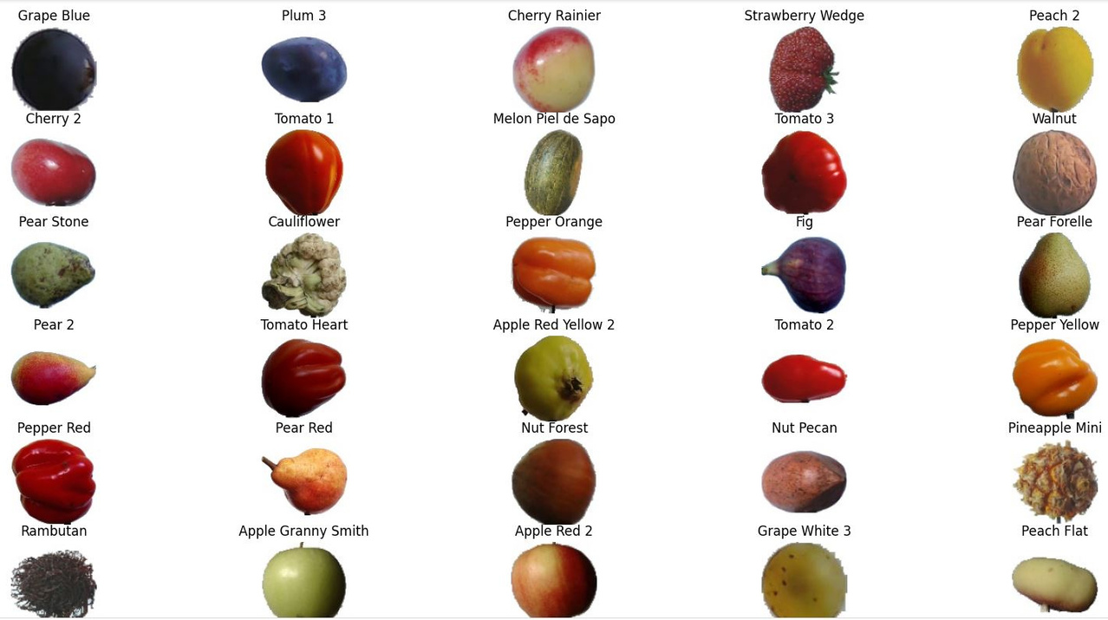
KEY FINDINGS
131 different fruits and vegetables 90,483 images.
Standardized 100x100 pixel format
Training set: 67,692 images
Test set: 22,688 images
Background removal algorithm used
Filming with Logitech C920 camera

Slide 7


APPROACH
Load Data
Data Preprocessing
Modeling

Slide 8


DATA PREPROCESSING
MODELING
Rescale
Data Augmentation:
rotation range
zoom range
width shift range
height shift range
horizontal flip
validation split
shear range
CNN Model With Augmentation
CNN Baseline Model
VGG Model With Augmentation
Effecientnent b0 Model Without Augmentation
RESNET Model With Augmentaion

Slide 9




RESULT
Train Accuracy
Validation Accuracy
Test Accuracy

Slide 10

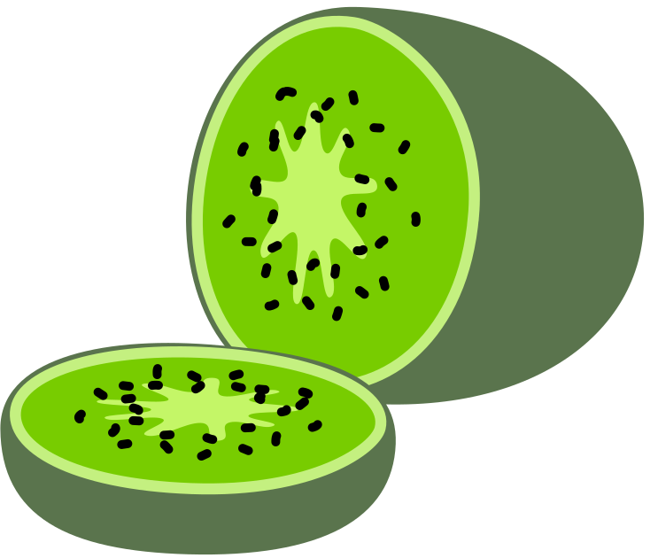



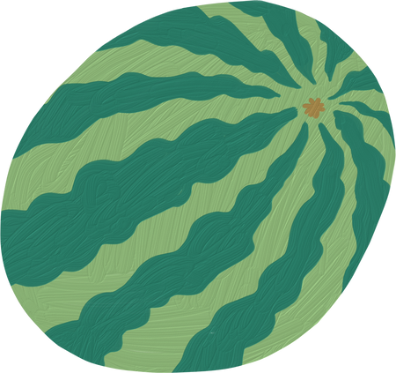

RESOURCES

Slide 11


THANK YOU!

